Slide 1
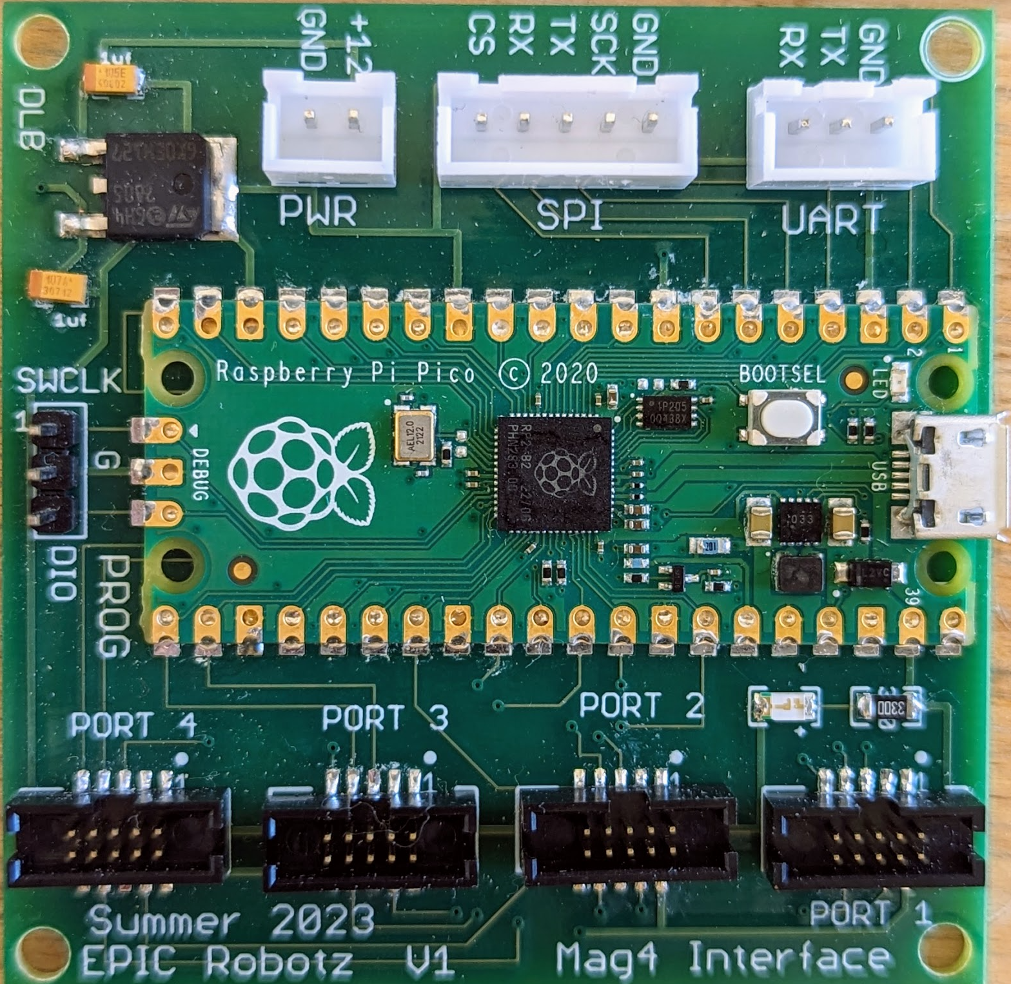
Mag4 Interface Device
EPIC Robotz
July 2023

Slide 2
The Mag4 Interface Device
Input
Power
SPI Interface
to RoboRio
UART (unused)
3 Wire
Debugging
Port
USB Port
for Programming
4 SRX Mag Encoder Ports

Slide 3
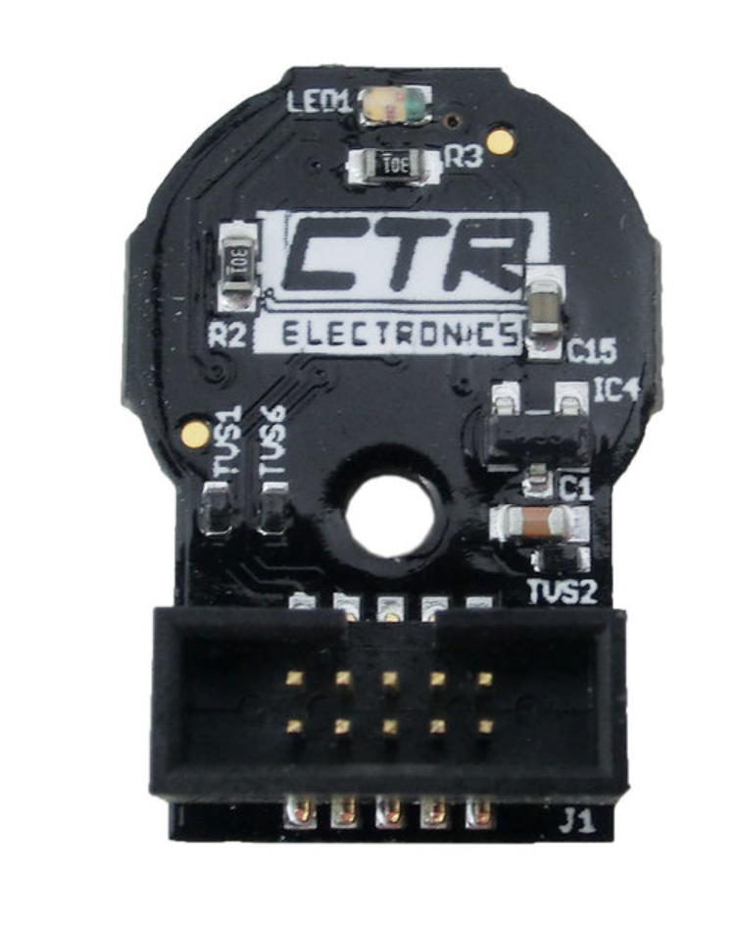
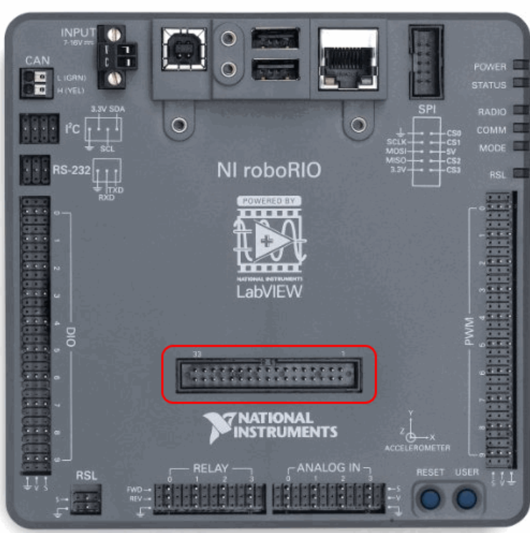
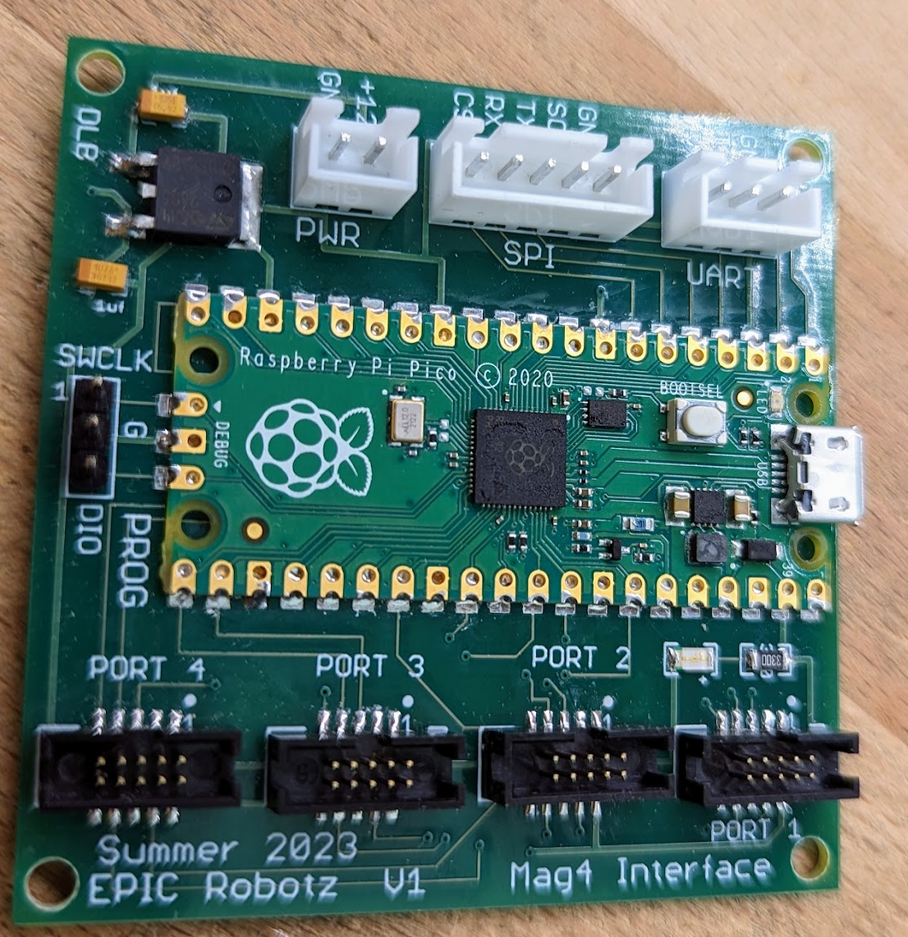
Purpose of the Mag4 Interface Device
Connect 4 SRX Mag Encoders to the RoboRio:
10 Wire Ribbon Cables that we
can make to any length.
Robo Rio
5 Wire SPI Cable
SRX Mag
Encoders
Mag4 Interface Device
12 Volt Power from PDP

Slide 4
Justification of Project
Current CANCoder cost $80 Each.
SRX Mag Encoders cost $40.
CANCoders crowd the CAN Bus
SRX Mag Encoders avoid CAN Bus by using SPI
CANCoders require individual Power Wires, as well as CAN wires
SRX Mag Encoders require single ribbon cable
Latency Is better with SRX Mag Encoders
0.3 milliseconds deterministic Latency
(However, Latency is NOT known to be a problem with CANCoders)
There is possibility of fusing PWM and Quadrature Readings At Source
More accuracy for reading absolute angles quickly

Slide 5
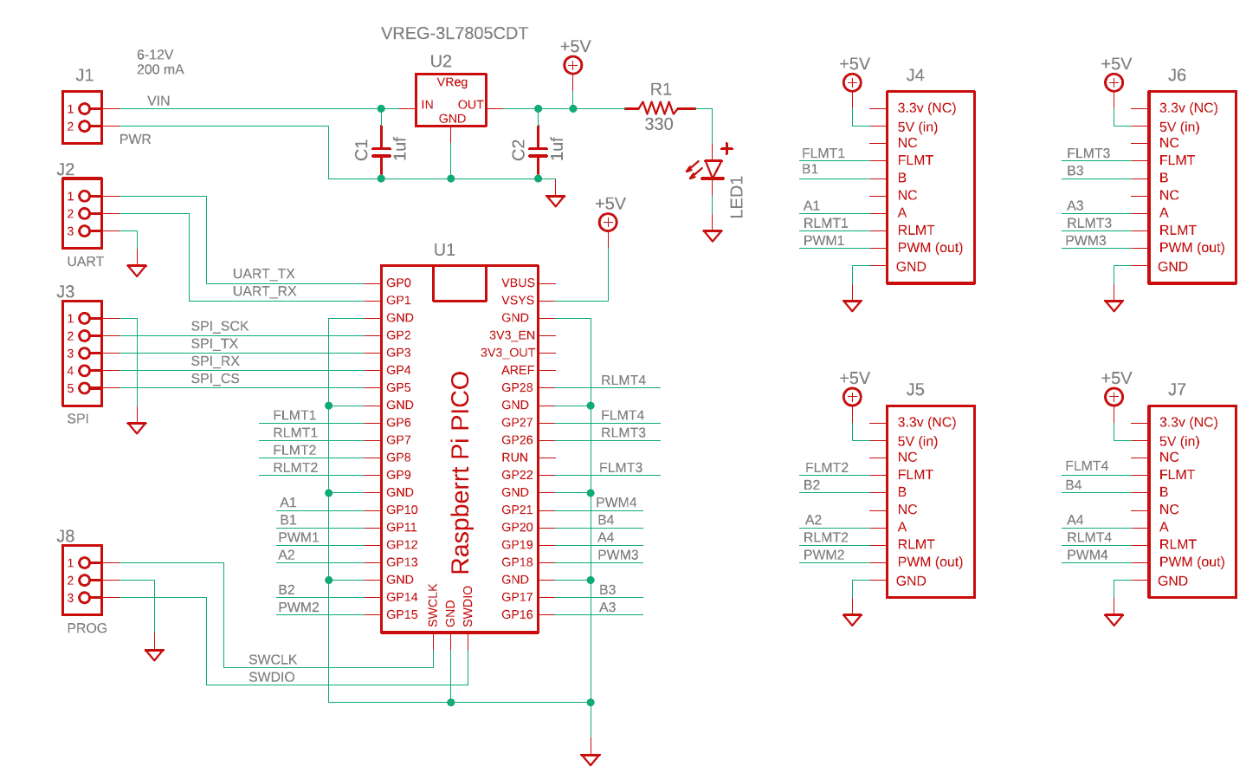
Mag4 Schematic

Slide 6
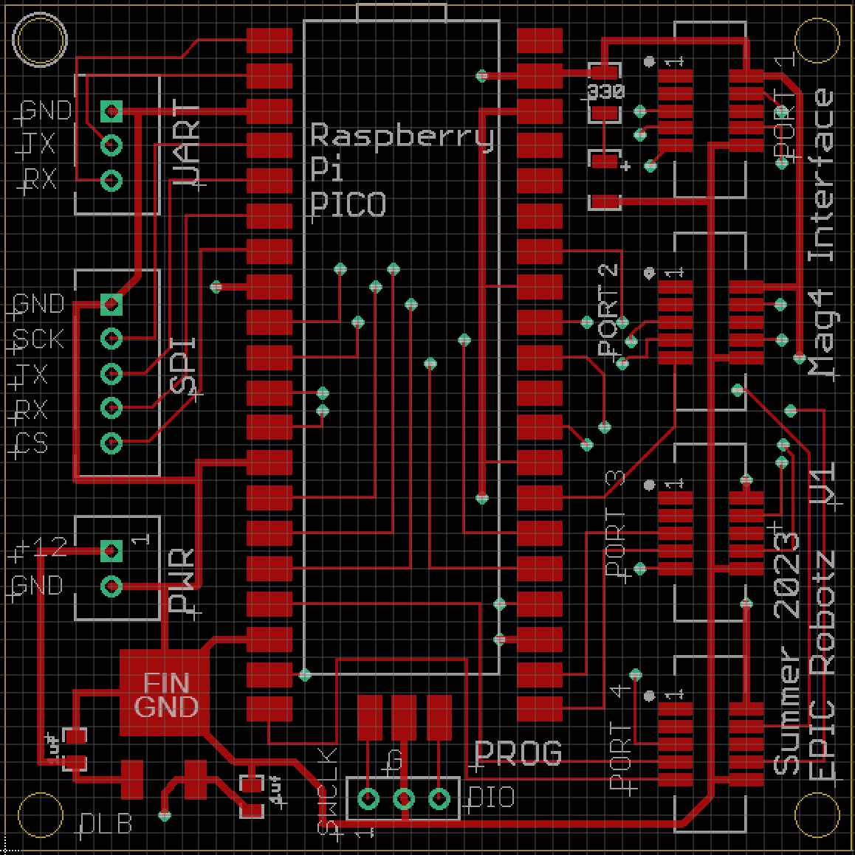
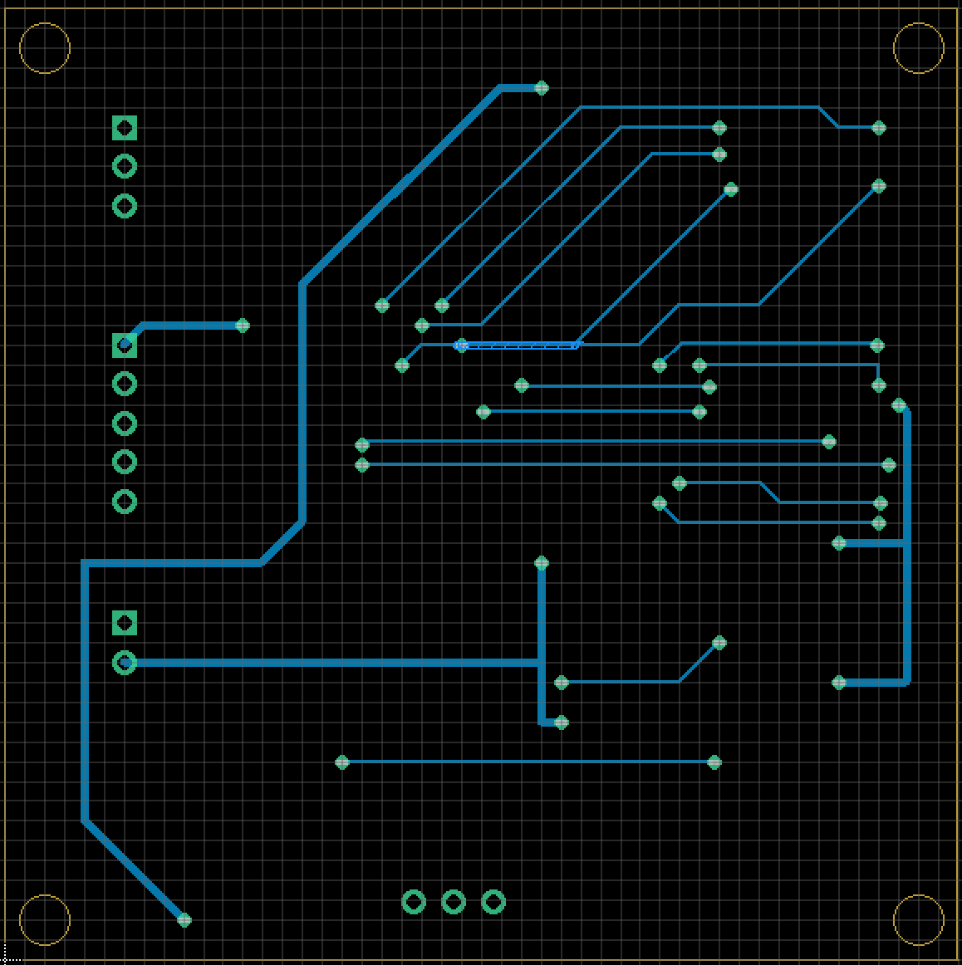
Mag4 PCB Layout
Top Copper and Silkscreen
Bottom Copper and Silkscreen

Slide 7
Bill of Materials
1x PCB -- From AllPCB
1x Raspberry Pi PICO Board -- From Amazon
4x 10-Pin Socket -- DigiKey, 1175-2649-1
1x LED, 1206 -- DigiKey, 732-4989-1
1x VReg 5V 1.5A, DPAK -- DigiKey, 497-7255
1x 330 ohm Res, 1206 -- DigiKey, RMCF 1206FT330RCT
2x Cap Tant, 1 UF, 1206 -- DigiKey, 478-2363
1x JST male Socket, 2 Pin -- From Amazon
1x JST male Socket, 3 Pin -- From Amazon
1x JST male Socket, 5 Pin -- From Amazon
1x 3-Pin Header, 0.1 Pitch -- From Amazon

Slide 8
Why use a Raspberry PICO?
(It’s a perfect fit for the Job!)
PICO is a new microprocessor that has a unique “programmable IO” block, which allows very fast sub-programs to monitor and react to incoming IO signals.
To correctly interface with a SRX Mag Encoder, three inputs must be monitored: Two Quadrature digital signals, and one PWM signal.
It turns out that the PICO has 8 state machines on it’s programmable IO block. Four of these are dedicated to monitoring the four PWM signals. The other four state machines are used the count the quadrature pulses.
The PICO also has two independent cores. One core can be dedicated to collecting the data, while the other core can be dedicated to communication with the host.

Slide 9
Software

Slide 10
Software to Simply Use the Mag4
Copy the java class “Mag4” to your Project. It is found under ../src/main/java/frc/robot/Mag4.java.
In your Robot Code:
import frc.robot.Mag4.Mag4Data;
In your code, create a Mag4 Object in your robot code:
Mag4 mag4 = new Mag4();
When you want the data from the Mag4 interface device, do:
Mag4Data data = mag4.getData();
float angle1 = data.angles[0];
// similar for other parameters)
getData() will require about 0.3 milliseconds to run.
The returned data will have a latency of just over 0.3 milliseconds.
The data object returned contains the pulse count and angle measurements for all four encoders.
Note that Mag4 does not run in the background or use multithreaded objects.

Slide 11


Software for Development
Two Categories: RoboRio and Raspberry Pi PICO
Setup for RoboRio according to FRC instructions.
Must use VSCode configured for RoBoRio:
Setup for Raspberry Pi PICO very Involved.
Must use VSCode configured for PICO:
I installed “Pico-v1.50” SDK for Windows
Pay special attention to environment variables:
PICO_INSTALL_PATH
PICO_SDK_PATH "C:/Program Files/Raspberry Pi/Pico SDK v1.5.0/pico-sdk“
I set PICO_SDK_PATH in pico_sdk_import.cmake file.
(Not recommended, but no good alternative).

Slide 12
Software Roadmap
For RoboRio
Main files are:
Mag4.java -- Contains the class that interfaces with the Mag4 device
Mag4Tester.java – Contains code for test board
Robot.java – Contains code to include Mag4Tester
For PICO
Main production code is under Mag4Pico/mag4
USE THIS TO BURN NEW DEVICES
The code on the PICO used to control the stepper motor for testing is under Mag4Pico/motordrive
This code can be used to control a generic stepper, both with a UART and USB at the same time.
(Found under: ../src/main/java/frc/robot)

Slide 13
Development Software for PICO
Name | Purpose | Status
adder | Experimenting with PIO blocks | Old, not important
blink | Misc Experiments | Old, not important
encoders | First versions of PWM reading | Obsolete
loopirq | Experiments with Interrupts | Useful as examples
mag4 | THE MAIN CODE | Used in production
magreader | SPI Experiments | Obsolete
motordrive | Stepper Motor Driver | Used for Test Board
pio_blink | Test ability of PIO to issue interrupt | Keep as an example
pwm_rd4 | For development of pwm reader. Written in c++ | Obsolete
pwm_reader | Earlier version of pwm reader | Obsolete
stepper | Earlier version of motordrive. Used with testman. | Old, but used with testman
testman | Python Program to control Stepper | Keep for Example

Slide 14
Thoughts on PICO Development
I LOVE THE PICO – Definitely my Go-To microprocessor!
Install SDK for Windows.
Must get environment variables set right!
Must use a preconfigured VSCode. Its tricky on how that is done.
The C SDK for PICO from Raspberry is excellent!
Understand what CMake is doing… CMake must be used.
IDE Debugging works for one of the two cores if using a picoprobe
DOES not work for both cores!
I tried the Arduino environment. Works for basic stuff, but many PICO specific features are not supported. Best to stick with C-SDK from Raspberry

Slide 15
Testing the Mag4 Device

Slide 16
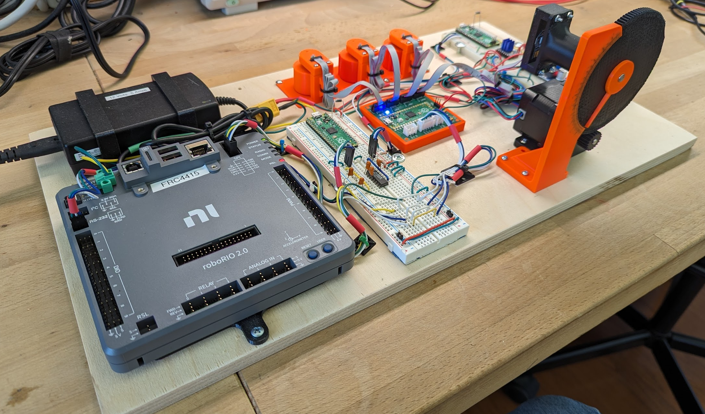
Mag4 Testing Board
3 Simulated Wheels, Hand Moved
Simulated Wheel
Moved with Stepper
Motor
12V Power
Supply
Stepper Motor
Circuit Board
Under Test
RoboRio
RS232 Interface
Circuit

Slide 17
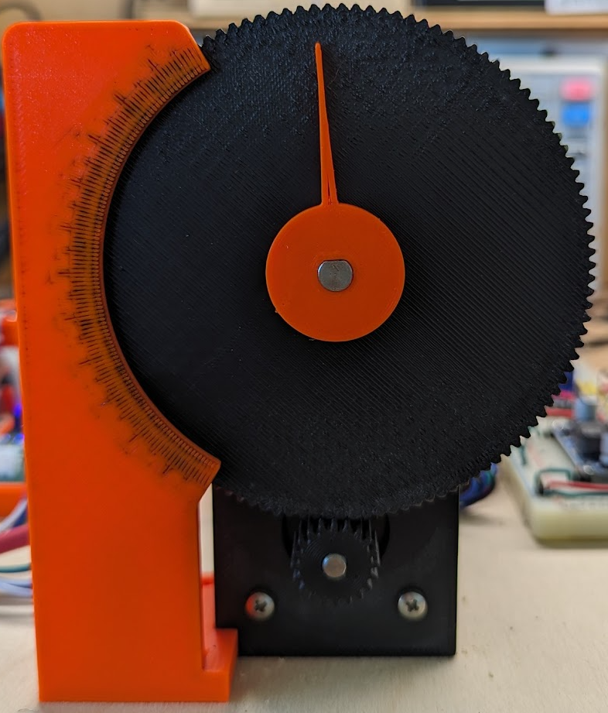
Block Diagram of Testing Board
Power Supply
PICO
Stepper
Controller
RS232 Convertor Circuit
Stepper Driver
SPI Breakout
For Testing
Note, for testing the RoboRio can command the stepper motor (via RS232)
to move to a position and then read the result over the SPI bus.
Stepper Motor

Slide 18
Running the Test Board Software
Use the FRC DriverStation and ShuffleBoard
A tab called Mag4 will appear on the ShuffleBoard
Under this tab, you can move the motor and watch the results.
Note that you do NOT need to be in “Enable Mode” for this to work,
As the RS232 interface bypasses FRC safety guidelines.
A tap called Mag4_Graph will also appear given graphs of the movement and sensor readings for Port 4.
Note that the buttons on the ShuffleBoard do not respond well… it might take some extra clicking to get the behavior you want.

Slide 19
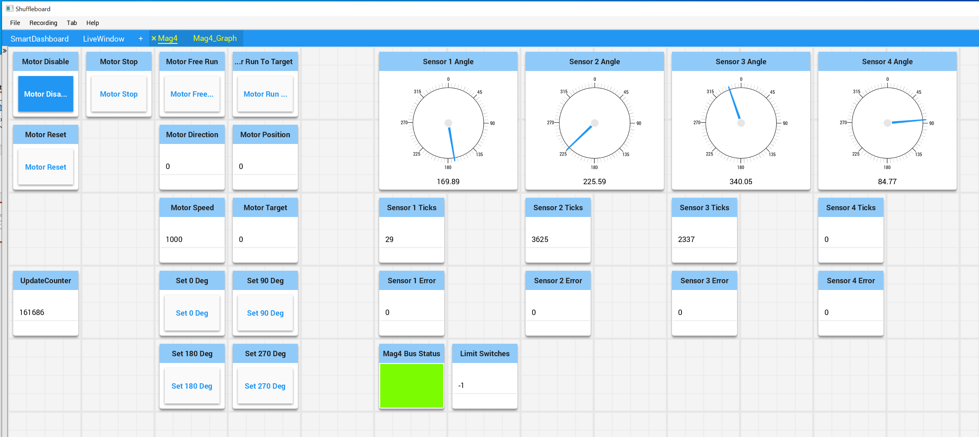
Example Test Results

Slide 20
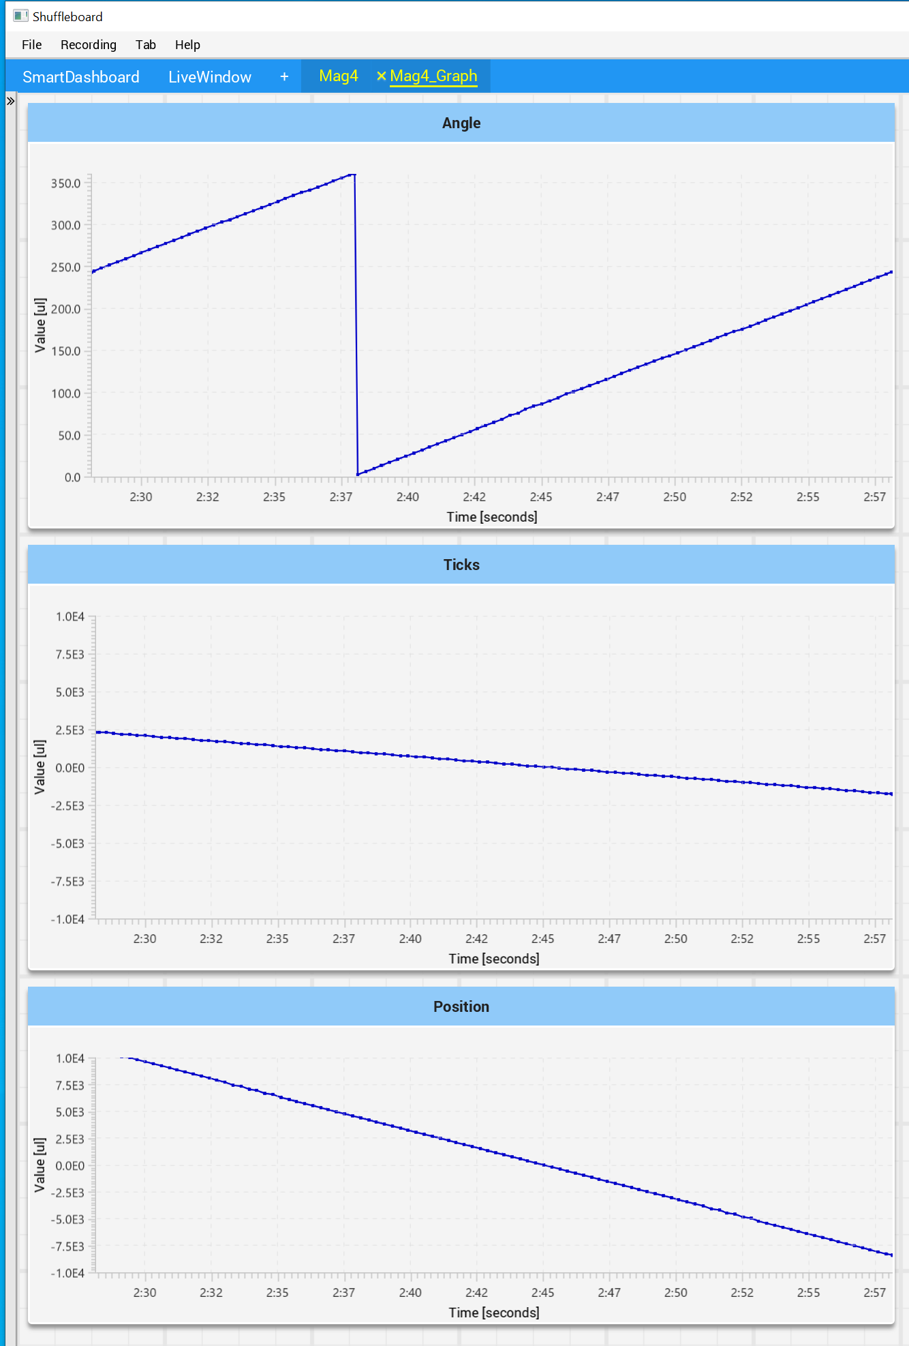
Example Test Results

Slide 21
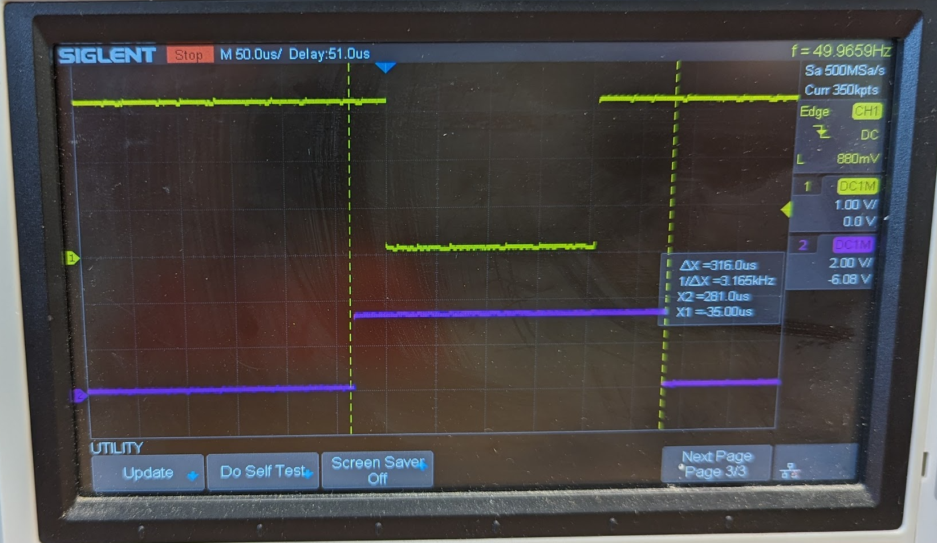
Timing Results
An oscilloscope was used to verify SPI and RoboRio Times
Here, the yellow trace is the CS assert sent by the RoboRio for one transfer. The blue trace is also a signal from the RoboRio (from a DIO line) to mark the time it takes to do the transfer. The cursors indicate 316 us for a transfer.
(We set the SPI Clock rate to be 1.8MHz)

Slide 22
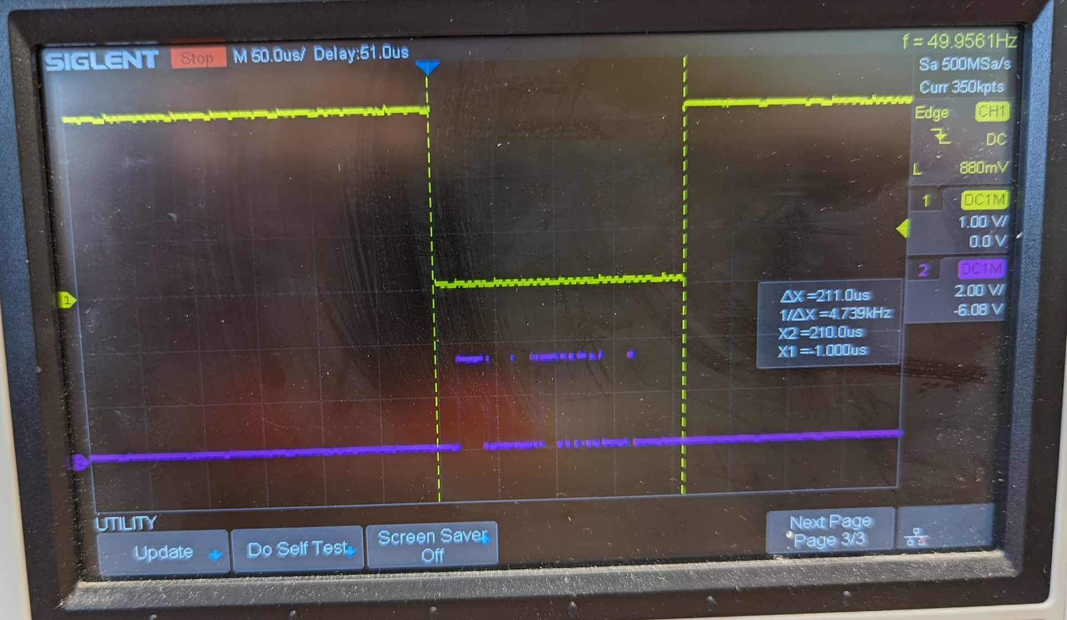
Timing Results, Part 2
This picture is similar to the previous, except here the blue trace is the data being transmitted from the Mag4 device.

Slide 23
Discussion of Data Fusion
A lot of work was expended trying to fuse the readings from the quadrature with the PWM signal that give absolute angle. The PWM signal arrives once every 4 milliseconds, whereas the quadrature arrives almost instantaneously – but gives only relative information.
The idea was to marry these. Once an absolute position is known, then one can observe the quadrature and calculate absolute position without reference to the PWM.
This was attempted. It worked by recording the quadrature count at the time a PWM pulse was decoded – these two values establish a datum. Thereafter, only the quadrature was used to calculate angle.
The algorithm was improved by noticing that one could calculate angular velocity with the quadrature – and that leads to an estimate of maximum possible error on the PWM measurements. Therefore, after every PWM pulse, the algorithm would update the datum if the possible maximum error was less than or equal from before. If the velocity was zero during a PWM pulse, then no error should be in the PWM signal, and the datum would be updated on very pulse. These last steps was an attempt to correct for a possible noisy PWM measurement.

Slide 24
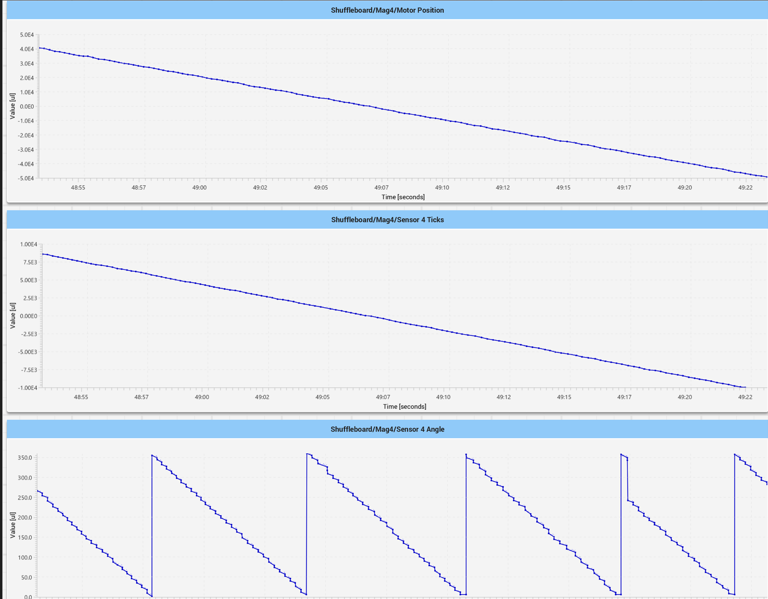
Results of Fusion Algorithm
To the left are test results of the fusion algorithm for the motor spinning at about 10 RPM. The first chart is the motor position over time, and the second is the raw quadrature count from the Mag4 device. The third chart is the reported angle.
The first two charts tell us that the motor is moving linearly, and that the Mag4 reports believable quadrature counts. However, the angles have problems, most notably at the red circles.
I believe this indicates that the algorithm has accepted an incorrect datum, and then is unable to update the datum because the continuous motion prevents another datum with a less maximum error estimate.
Unfortunately, the algorithm fails. Currently the Mag4 is configured to only return raw angle measurements from the PWM. No fusion is attempted.

